Slide 1
Building Single page applications

Slide 2
What’s the deal with internet thing?
Dude, have you seen this internet thing?
Browsers are getting cooler and more powerful
User expectations are going up

Slide 3
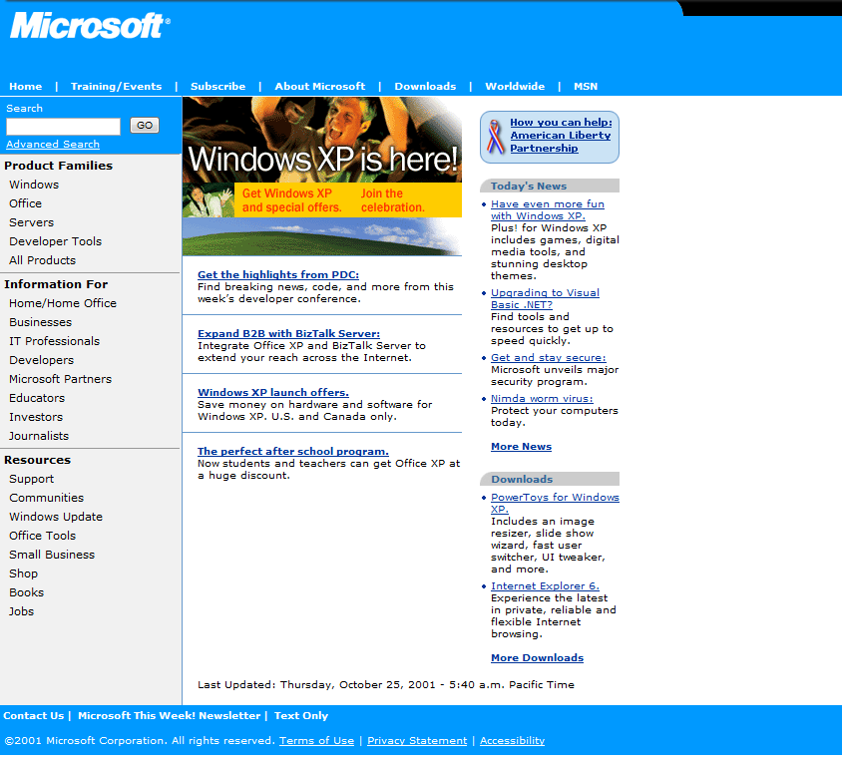

Slide 4
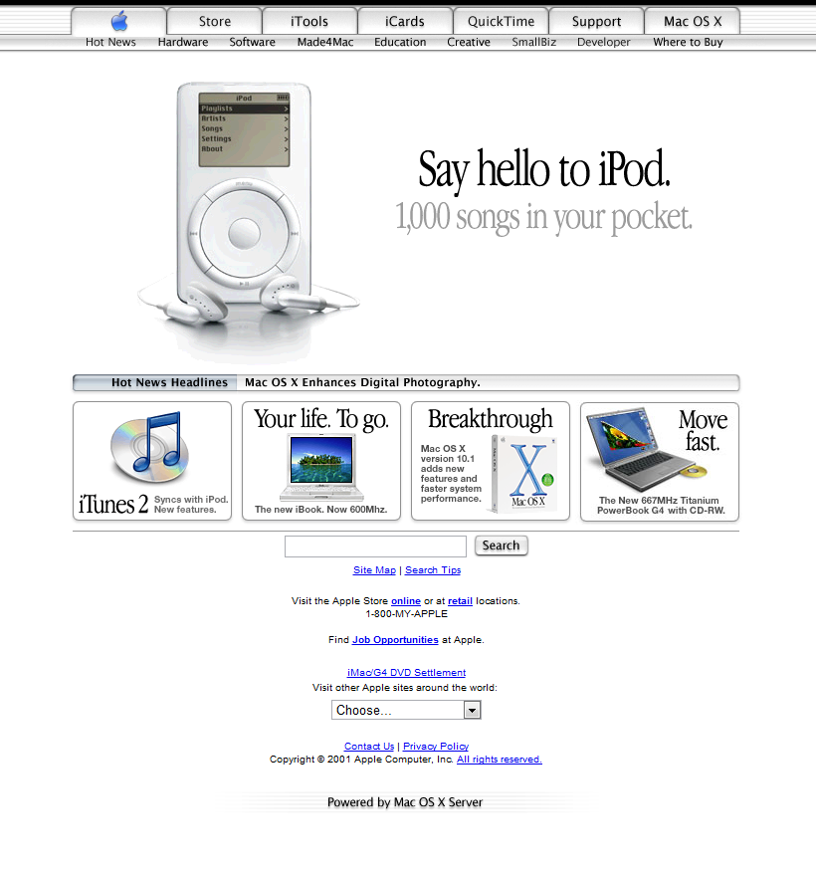

Slide 5
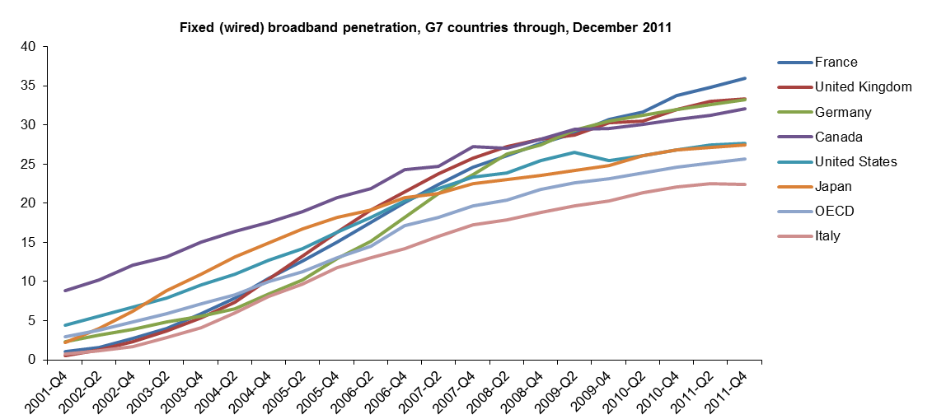
Broadband is way up

Slide 6
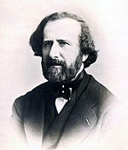
But browsing the net can still be slow
One of the first estimates of the speed of light
315 000 km/s
~5% of modern value
Hippolyte Fizeau
(1819-1896)

Slide 7
Shifting functionality to the browser
AJAX
Fast JavaScript
Great JavaScript libraries
Browser Data Storage

Slide 8
MVC + mvvm

Slide 9
Model view controller
Controller
Model
View

Slide 10
Model View View-Model
Model
ViewModel
View

Slide 11
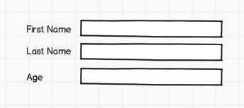
Observable model
Model

Slide 12
How can asp.net mvc help with ajax?
Controllers can take and return JSON
WebAPI allows for RESTful services
JavaScript minification and concatenation

Slide 13
Returning and consuming json
Demo

Slide 14
WEB API
Demo

Slide 15
Javascript minification and bundling
Demo

Slide 16
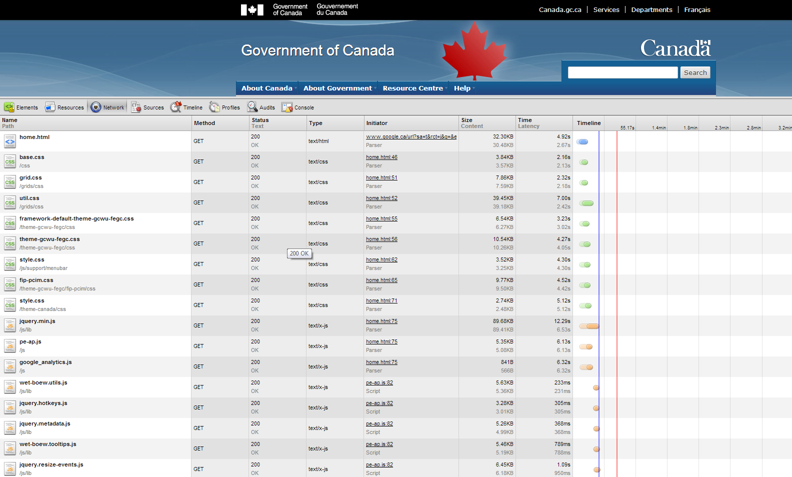

Slide 17
Knockout.js
Demo

Slide 18
Some examples
http://quote.azurewebsites.net/
http://moduletracker.com/
http://welltrkd.com

Slide 19
Where it gets hard
Tons of javascript
No namespaces
No class inheritance
No tests
No, you can write large programs in JavaScript. You just can’t maintain them.
Anders Hejlsberg

Slide 20
What to do?
Don’t write large programs
Write small programs with well defined interactions

Slide 21
Namespacing javascript
Demo

Slide 22
Prototype based inheritance
Demo

Slide 23
Use other tools
Coffeescript is a strong alternative to JavaScript
There are many, many others http://altjs.org/
JavaScript is an assembly language. The JavaScript + HTML generate is like a .NET assembly. The browser can execute it, but no human should really care what’s there. -
Erik Meijer

Slide 24
Testing javascript
Demo

